Slide 1
Methods 1 Lab
Lecture 12

Slide 2
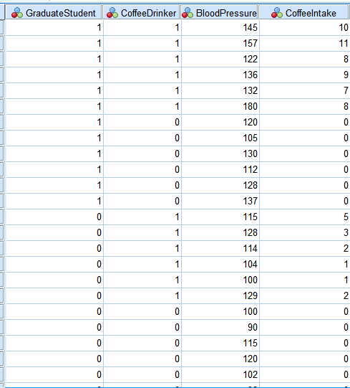
Data
Get the data from Moodle into SPSS
Lecture 12 Data

Slide 3
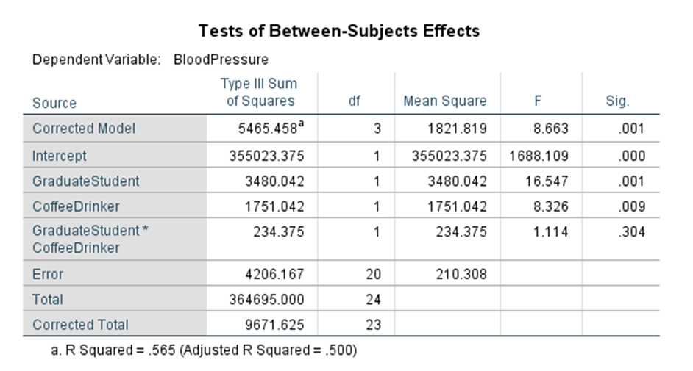
2 Way ANOVA
Analyze
General Linear Model
Univariate
Dependent Variable – Coffee Intake
Fixed Factors – GraduateStudent & CoffeeDrinker
Ok

Slide 4
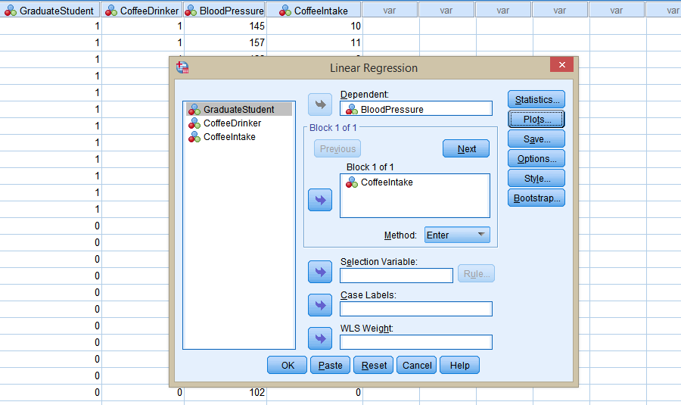
Regression
Analyze
Regression
Linear
Dependent – BloodPressure
Block 1 0f 1 – CoffeeIntake
Plots
Y - *ZRESID
X - *ZPRED
Check Histogram and Normal Probability Plot
Ok

Slide 5
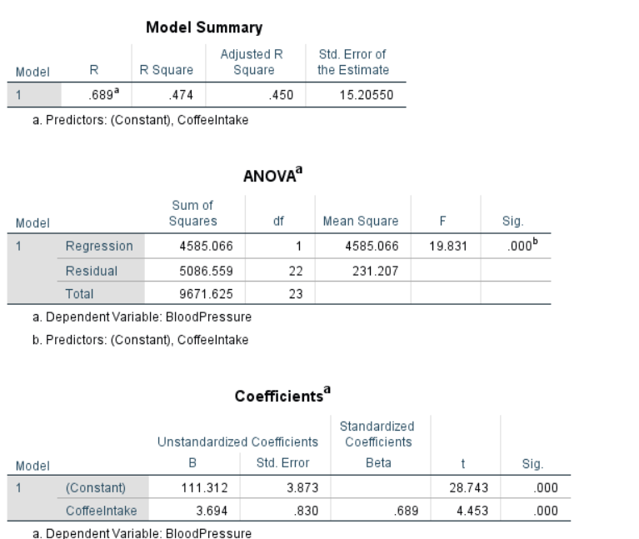
Regression
R-squared = .474 -> this means that approximately 47% of the variation in Blood Pressure can be explained by Coffee Intake
Beta = 3.694 -> for every 1 unit increase in Coffee Intake there is on average an increase in Blood Pressure by 3.694 units.

Slide 6
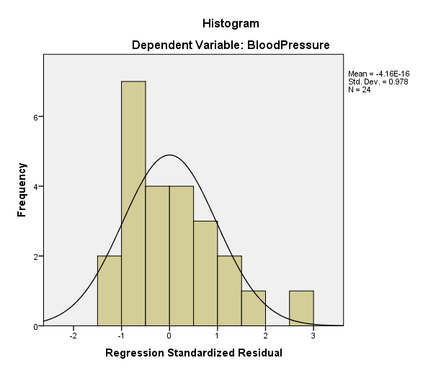

Slide 7
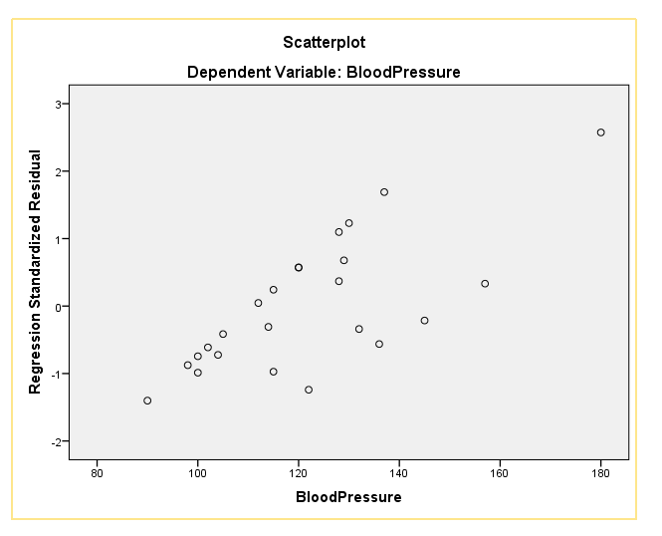

Slide 8
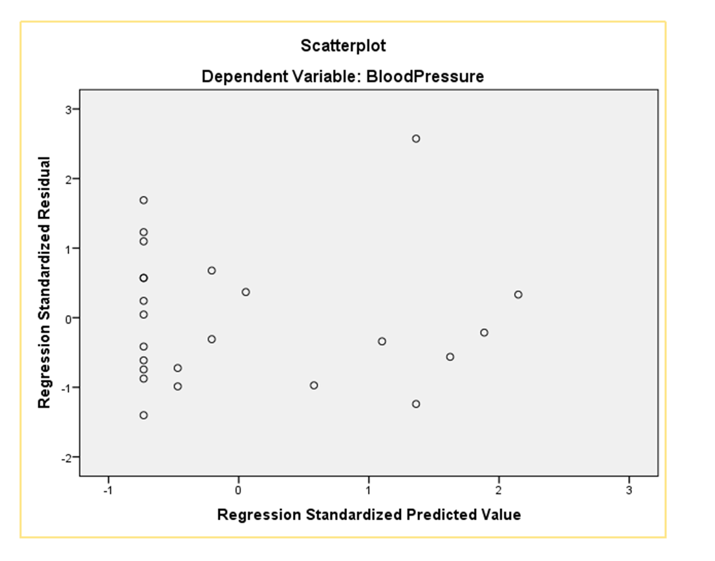

Slide 9
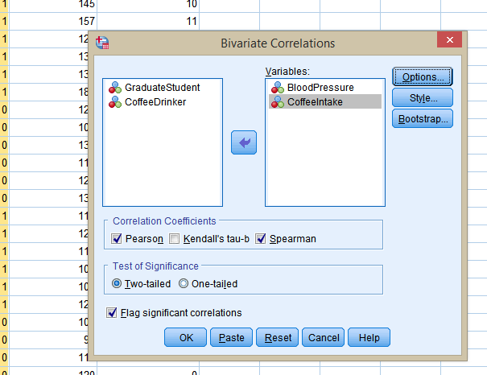
Correlation
Analyze
Correlate
Bivariate
Check Pearson and Spearman
Ok

Slide 10
